Slide 1
First Connection Strategy
Allow the user to select one individual run to be displayed on STRESS platform map across all countries (not just EPPA regions)
ex. user is interested in runs that satisfy certain criteria: user can have data from one run displayed on the STRESS platform

Slide 2
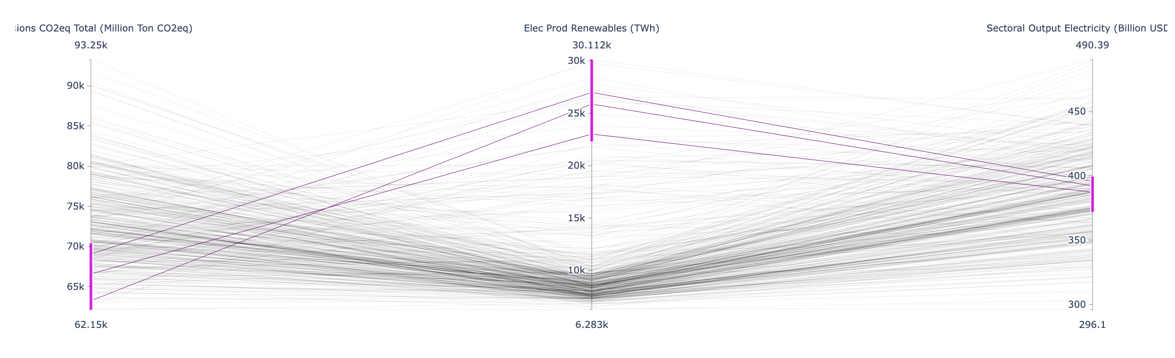
Scenario Discovery → STRESS
User creates criteria (ranges of inputs and/or outputs) to filter for runs of interest

Slide 3
Scenario Discover → STRESS
2. User selects one of these runs to be displayed on STRESS
a) What this would probably look like is the user is able to see
the run #s of each run, and then manually enters the run #, scenario, output, and year to display data for
3. User hits a button that triggers an API call that sends the requested data to STRESS, where it is displayed on the map

Slide 4
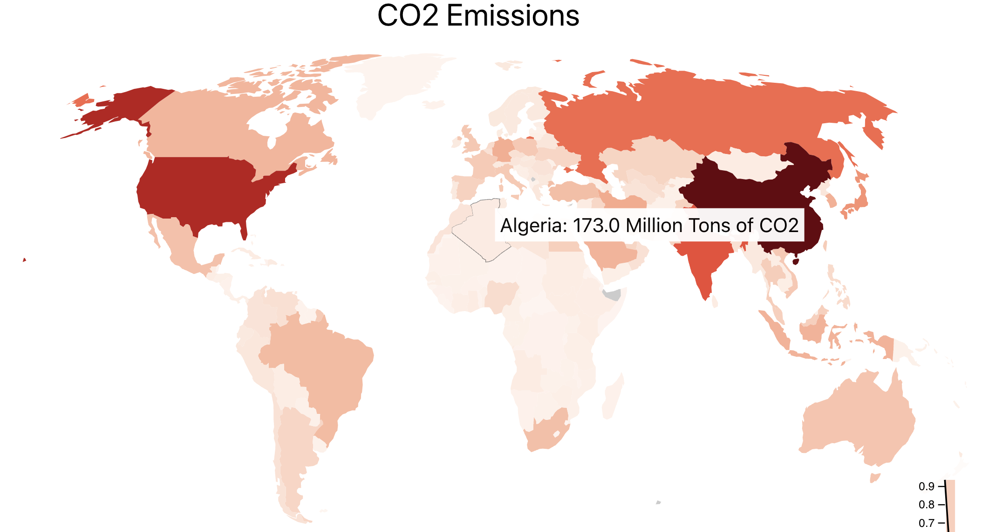
Process Overview
User selects scenario, output, year, run#
Scenario discovery sends data to STRESS through an API
Data for this particular run is displayed on STRESS on a country- by-country bases
Carbon emissions (CO₂eq)
Ref 2050 Run #247
{“USA”: 6069, “CHN”: 17700, “EUR”: 4934…,
“Scenario”: “Ref”, “Year”: 2050, “Output”: “emissions_CO2eq_total_million_ton_CO2eq”, “Run”: 247}

